Slide 1

AtliQ Mart is a retail giant with over 50 supermarkets in the southern region of India. All their 50 stores ran a massive promotion during the Diwali 2023 and Sankranti 2024 (festive time in India) on their AtliQ branded products. Now the sales director wants to understand which promotions did well and which did not so that they can make informed decisions for their next promotional period.
Sales director Bruce Haryali wanted this immediately but the analytics manager Tony is engaged on another critical project. Tony decided to give this work to Peter Pandey who is the curious data analyst of AtliQ Mart. Since these insights will be directly reported to the sales director, Tony also provided some notes to Peter to support his work.
AtliQ Mart

Slide 2
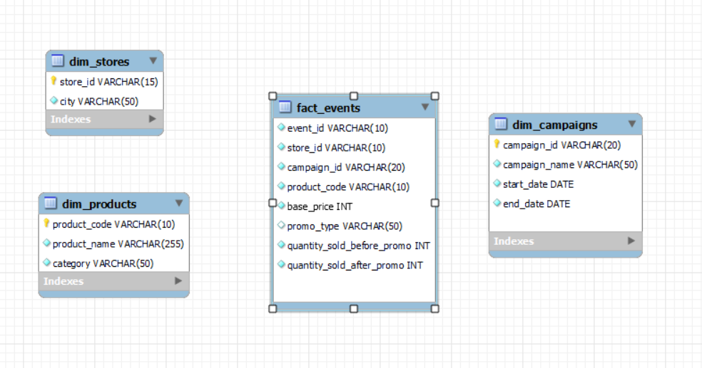
INPUT DATA AND SCHEMA
AtliQ Mart

Slide 3
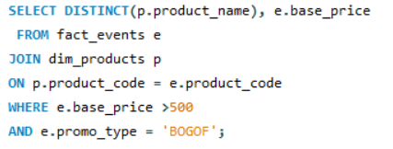

Provide a list of products with base price greater than 500 and that are featured in promo type of 'BOGOF' (Buy One Get One Free).
Atliq Double Bedsheet set and Atliq waterproof Immersion Rod are the two products with base price greater than 500 and that are featured in promo type of 'BOGOF' (Buy One Get One Free)
AtliQ Mart

Slide 4
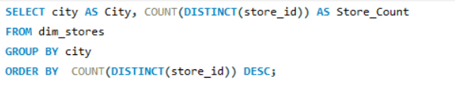
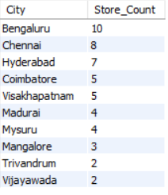
2. Generate a report that provides an overview of the number of stores in each city.
According to the report Bengaluru, Chennai and Hyderabad have higher number of stores
AtliQ Mart

Slide 5
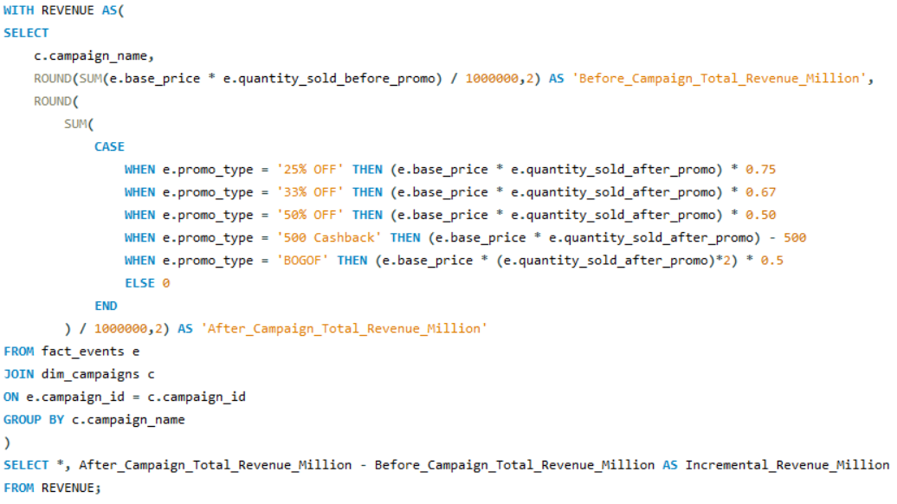
3. Generate a report that displays each campaign along with the total revenue generated before and after the campaign?
The revenue has increased after the campaign but during the Diwali the revenue is increased significantly
AtliQ Mart

Slide 6
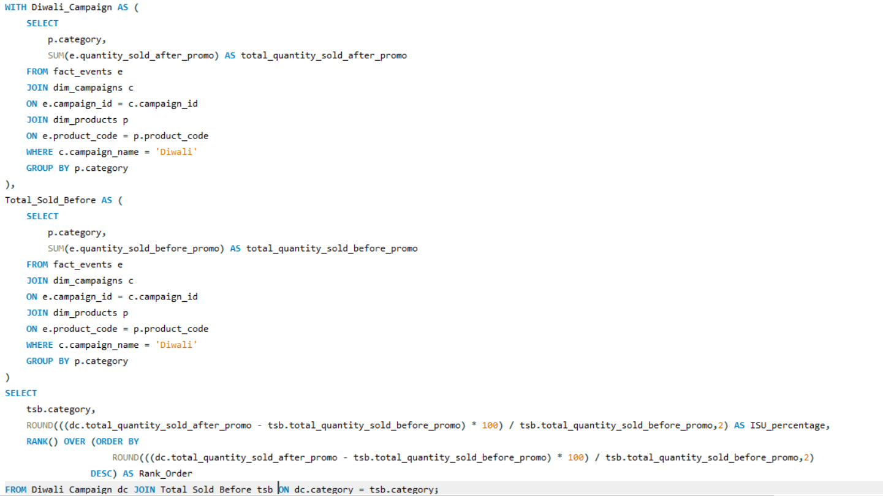
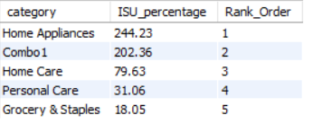
4. Produce a Report that calculates the Incremental Sold Quantity (ISU%) for each category during the diwali campaign. Additionally, provide rankings for the categories based on their ISU%.
Home Appliances category exhibits the highest ISU% increase, followed by the Home Care and Combo1 categories. Notably, there is a remarkable 588% ISU% surge in the Home Appliances category, while Home Care is at 203.14%, Combo1 follows closely behind with a 202.36% increase.
AtliQ Mart

Slide 7
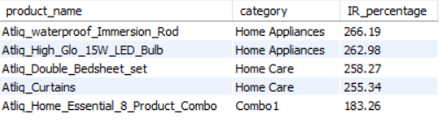
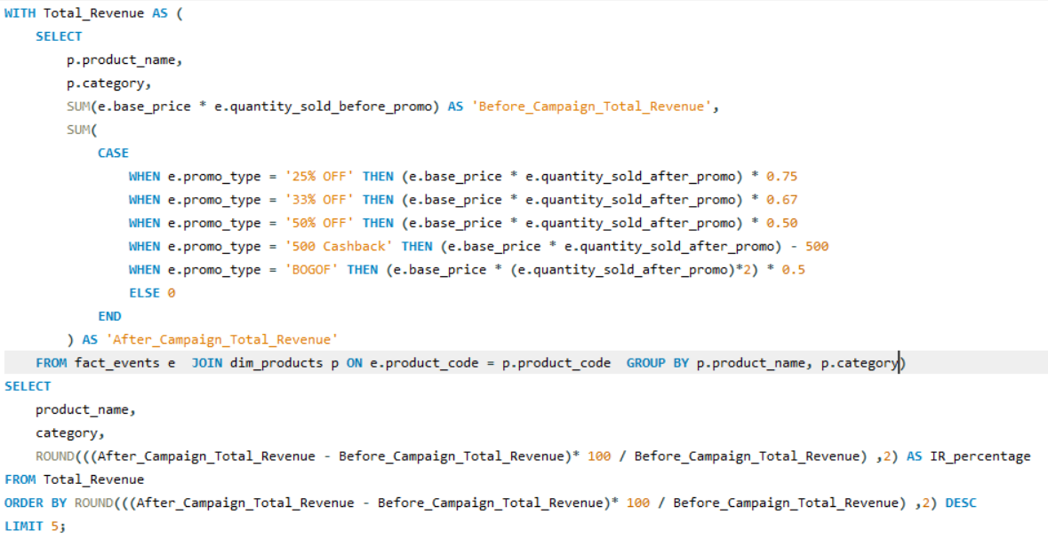
5. Create a report featuring the Top 5 products, ranked by Incremental Revenue Percentage (IR%), across all campaigns.
Atliq_waterproof_Immersion_Rod leads with an IR% of 266.19%, closely followed by Atliq_High_Glo_15W_LED_Bulb with an IR% of 262.98%. Atliq_Double_Bedsheet_Set, Atliq_Curtains, Atliq_Home_Essential_8_Product_Combo made significant contribution to revenue generation.
AtliQ Mart

